Slide 1
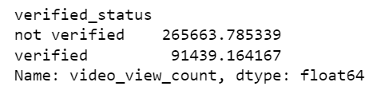
Executive Summary of Statistical Testing Results
Presented by TikTok Data team
Project Overview
TikTok leadership ask data team to develop a predictive model that can determine whether a video contains a claim or offers an opinion to reduce the backlog of user reports and prioritize them more efficiently. In this part of project, the data team conduct a hypothesis testing to analyze the relationship between verified_status and video_view_count.
The TikTok data team conducted 2 approaches to examine the relationship between verified_status and video_view_count.
The first approach was to examine the mean values of video_view_count for each group of verified_status from the sample data.
The analysis shows that there is a difference in number of view counts between verified and unverified accounts.
From this result, we can conclude that there might be a fundamental behavioral differences between verified and unverified accounts.
We will need to investigate more to understand this behavioral differences.
The second approach was two-sample hypothesis test. Similar with the first approach, the second approach also shows that the difference in the sample data is due to actual difference in the population means.
The data team suggests continue with the project with building a regression model on verified_status.
This regression model for verified_status can help analyze better user behavioral.

